Slide 1
Consultancy services for the FUNAFUTI water AND SANITATION project (FWSP) PROJECT PREPARATION PHASE 1 & PHASE 2 Consultant’s Presentation
PACOC MTR – April 2024

Slide 2
THIS PRESENTATION
Project Preparation Study Objective, Components, Deliverables and Staging
Study Progress Summary – Phase 1 - Stages A, B and C
Scope – Future Funafuti – 2030, 2040 and 2050
Water Supply
Sanitation
Cost Estimates and Construction Scheduling
Phase 2 Scope
Discussions and Questions
2.

Slide 3
PROJECT PREPARATION PHASE 1 1. STUDY OBJECTIVES,COMPONENTS, Deliverables and Staging
3.

Slide 4
PPP1 – STUDY OBJECTIVES
To assist the Government of Tuvalu (GoT) to prepare the proposed Funafuti Water and Sanitation Project (FWSP) with preparation of water supply and sanitation asset condition reports, future investment options, master plans, strategic plans, feasibility studies and project due diligence.
4.

Slide 5
PPP1 – STUDY STAGING
STAGE A
INCEPTION REVIEW
STAGE B
PLANNING
STAGE C
PROJECT FEASIBILITY & DUE DILIGENCE
Inception
Report
Existing Water
Supply Asset
Mapping and
Condition
Assessment
Water Supply
& Sanitation
Master Plans
Water Supply
& Sanitation
Strategic Plan
Feasibility
Studies
Investment
Project Due
Diligence
Mobilization
WSS Assets -
Data Collection
& Mapping
Water Supply
& Sanitation
Investment
Options
Water Supply
& Sanitation
Strategic Plan
Feasibility
Studies
Water Supply
Stakeholder
Analysis
Data collection
and review
Gender Action
WSS Assets -
Assessment
& Valuation
Reporting
Feasibility
Studies
Sanitation
Financial
Water Supply
& Sanitation
Master Plans
Facilitate
Inception
Workshop
Economic
Resettlement
Plan & Comms.
Reporting
Reporting
Reporting
Reporting
Environmental
Procurement
Progress summary in previous presentations
5.
Progress update covered in this presentation.

Slide 6
PROJECT PREPARATION PHASE 1 2. Study Progress SUMMARY - Stages A , B and C - Responses to issues arising -Rescheduling for GEF Options
6.

Slide 7
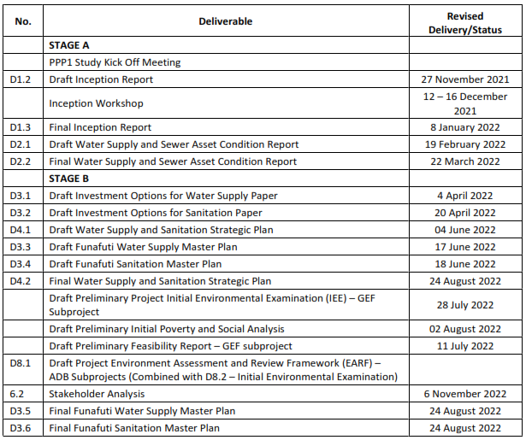
2. Study Progress summary – Stages A and B
7.

Slide 8
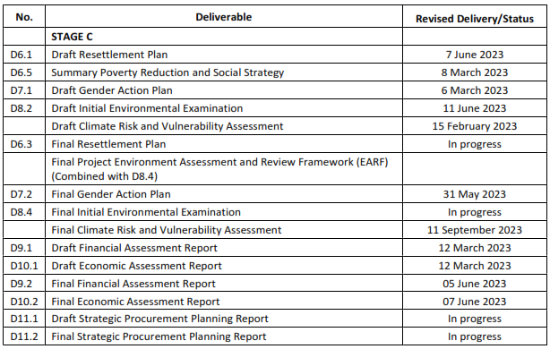
2. Study Progress summary – Stage C
9.

Slide 9
PROJECT PREPARATION PHASE 1 fEASIBILITY Investments - SCOPE - Future Funafuti – 2030 and 2040 - Water Supply - Sanitation
10.

Slide 10
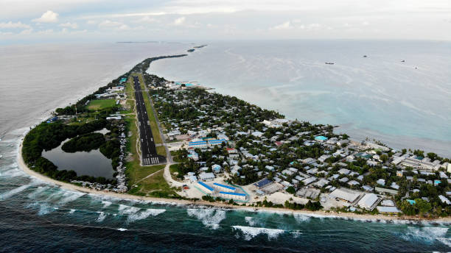
Feasibility Investments – Future Funafuti – 2030 and 2040
2030
2050
%
national population
Projected Population (medium) – 9,685
In Funafuti – 80.0%
Projected Population (medium) – 14,565
Females – 4,610 and Males – 5,075
Females – 5,636 and Males – 6,204
Females – 6,933 and Males – 7,632
%
national population
Projected Population (medium) – 11,840
In Funafuti – 74.5%
%
national population
In Funafuti – 85.0%
2040
11.

Slide 11
Feasibility Investments – Future Funafuti – 2030, 2040 and 2050
Access Level and Typical Volumes used in the home ª | Accessibility of Water Supply | No of Households Covered with metered connection | Adequacy for Health Needs | Level of Health Concern ^{b}
Inadequate access (quantity collected can be below 5.3L/person/day) | More than 1 kilometre in distance or 30 minutes total collection time | 0% | Drinking – cannot be assured Cooking – cannot be assured Hygiene - cannot be assured at the home, ^{c} compromising food hygiene, handwashing and face washing, other hygiene activities have to be undertaken away from home | Very high
Basic access ^{d} (average quantity unlikely to exceed 20L/person/day) | 1– 1,000m in distance or 5-30 minutes total collection time | 30% | Drinking – should be assured Cooking – should be assured Hygiene - food hygiene, handwashing and face washing may be assured; bathing and laundry cannot be assured at the home but may be carried out at, water source | High
Intermediate access (average quantity about 50L/person/day ^{e}) | Water delivered through one tap on household plot, or within 100 m or 5 minutes total collection time | 60% | Drinking – assured Cooking – assured Hygiene – all food hygiene, handwashing and face washing assured under non-outbreak conditions; enhanced hygiene during infectious disease outbreaks not assured; bathing and laundry at the home should also be assured | Medium
Intermediate access (average quantity about 50L/person/day ^{e}) | Water delivered through one tap on household plot, or within 100 m or 5 minutes total collection time | 100% | Drinking – assured Cooking – assured Hygiene – all food hygiene, handwashing and face washing assured under non-outbreak conditions; enhanced hygiene during infectious disease outbreaks not assured; bathing and laundry at the home should also be assured | Medium
Water Supply
2030
2040
2050
12.

Slide 12
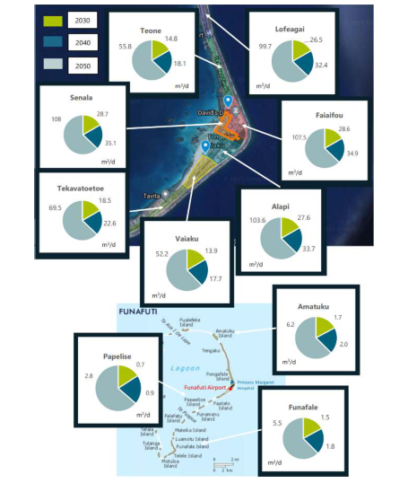
Feasibility Investments – Future Funafuti – 2030, 2040 and 2050
Water Supply
13.

Slide 13
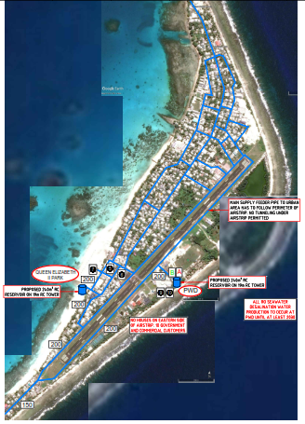
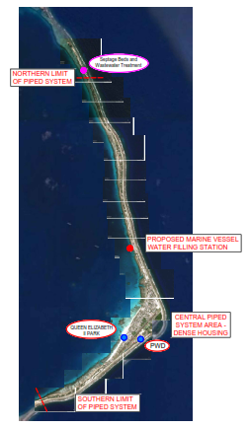
Feasibility Investments
– Future Funafuti
– 2030 and 2040
Water Supply
14.

Slide 14
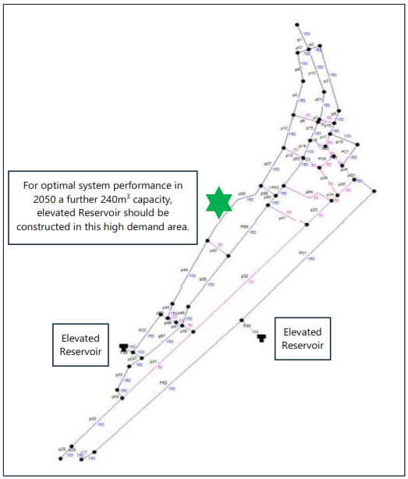
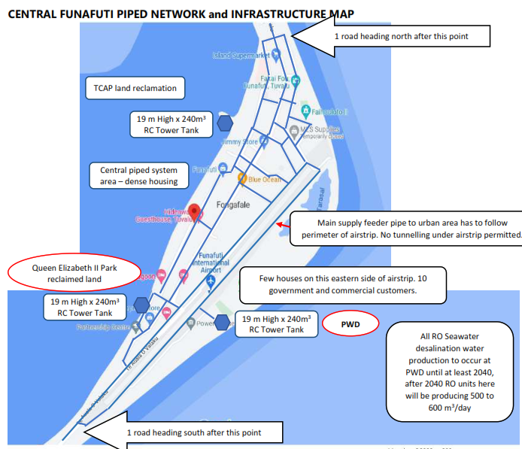
Feasibility Investments – Future Funafuti – 2030 and 2040
Water Supply
14.

Slide 15
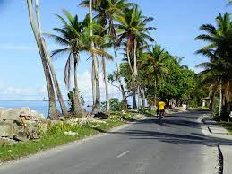
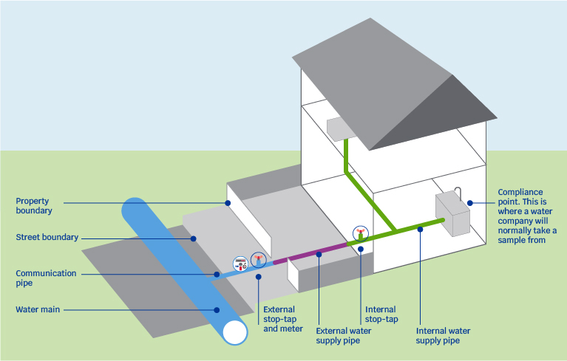
Feasibility Investments – Future Funafuti – 2030 and 2040
Water Supply
Typical service connection
Typical pipeline route mapping
200 mm
16.

Slide 16
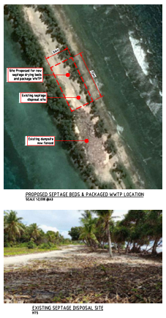
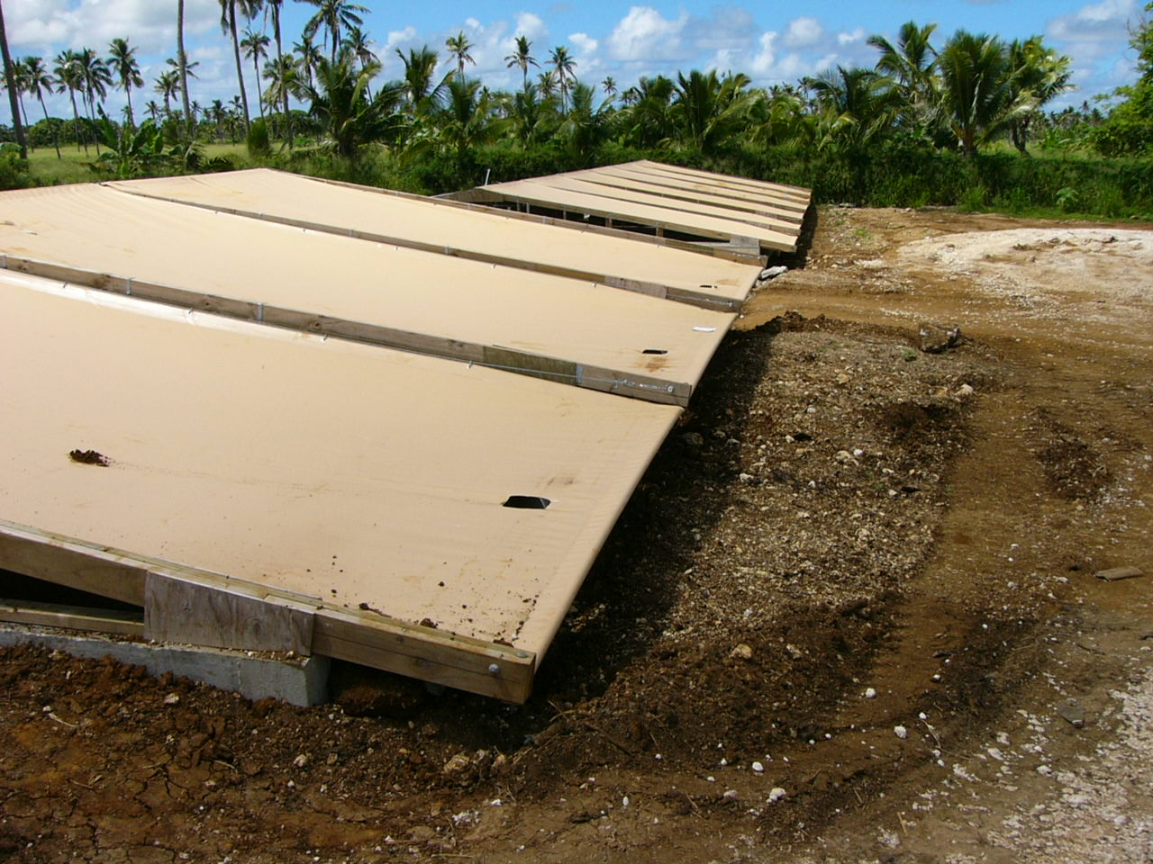
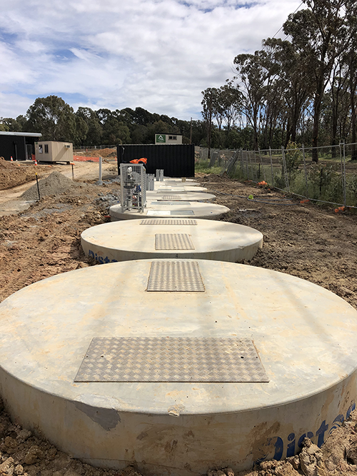
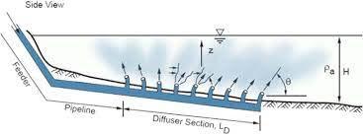
Feasibility Investments – Future Funafuti – 2030 and 2040
Sanitation
17.

Slide 17
PROJECT PREPARATION PHASE 1 fEASIBILITY Investments - SCOPE - Future Funafuti – 2030 and 2040 - cost estimates - Construction scheduling
18.

Slide 18
Feasibility Investment Cost Estimates
Estimated Costs US$
Water Supply
Without Taxes & Duties
Civil Works
US$9.853 mill.
Plant & Equipment
US$0.475 mill.
TA Support
Project Management Support (incl. PMU)
US$1.884 mill.
Financial Management & Tariff Setting
US$0.050 mill.
Legislative & Regulatory
US$0.050 mill.
Community Communication & Awareness
US$0.100 mill.
Health Education & Hygiene Action Plan
US$0.100 mill.
US$12.512 mill.
19.

Slide 19
Feasibility Investment Cost Estimates
Estimated Costs US$
Sanitation
Without Taxes & Duties
Civil Works
US$1.863 mill.
Plant & Equipment
US$0.517 mill.
TA Support
Project Management Support
US$.471 mill.
Financial Management & Tariff Setting
US$0.050 mill.
Community Communication & Awareness
US$0.50 mill.
Health Education & Hygiene Action Plan
US$0.50 mill.
US$3.001 mill.
20.

Slide 20
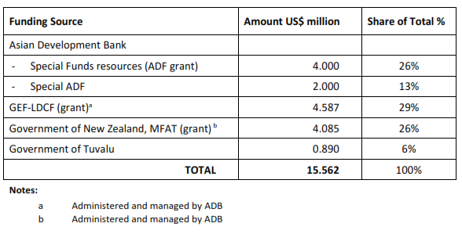
Feasibility Investment Cost Estimates
21.

Slide 21
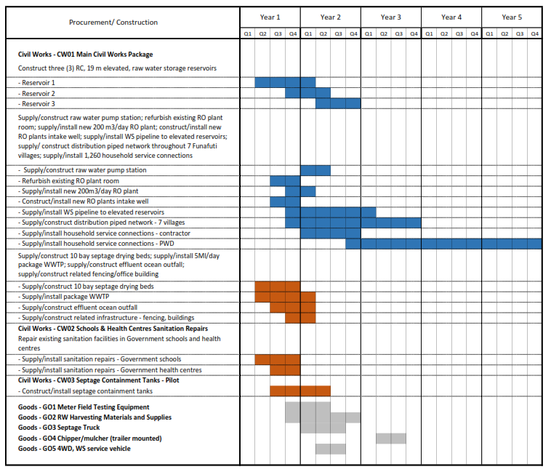
Feasibility Investment – Procurement/Construction Scheduling
22.

Slide 22
PROJECT PREPARATION PHASE 2 Scope of services
23.

Slide 23
Phase 2 - Services
Phase 2 | Required Reports/Deliverables
1.1 | Draft Detailed Engineering Design including expert's contribution on environmental, RP, Health and Safety issues
1.2 | Final Detailed Engineering Design including expert’s improvements following Client and ADB review and approval
2 | Capacity Building support plan
3.1 | Draft bidding documents including expert contribution on environmental, RP, Health and Safety issues
3.2 | Final bidding documents including expert’s improvements following Client and ADB review and approval
24.

Slide 24
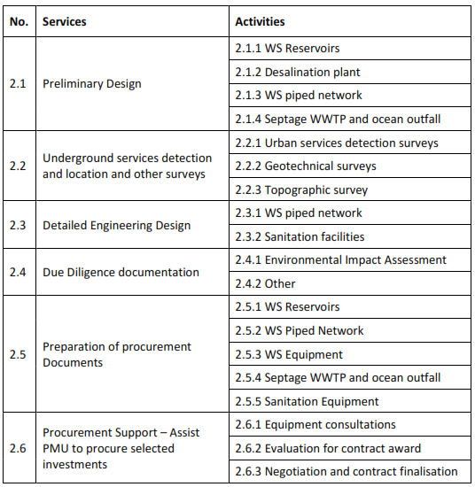
Phase 2 - Services
24.

Slide 25
PROJECT PREPARATION PHASEs DISCUSSION and Questions
25.

Slide 26
Questions
26.

Slide 27
Faka fetai
Thank you
27.

